Slide 1

Introduction to ActivInspire and the Promethean Board
Dr. Steve Broskoske
TED 121 Educational Technology
Misericordia University

Slide 2
Prepare: Download Software
You can download a FREE copy of ActivSoftware at the following link:
support.promethean world.com

Slide 3
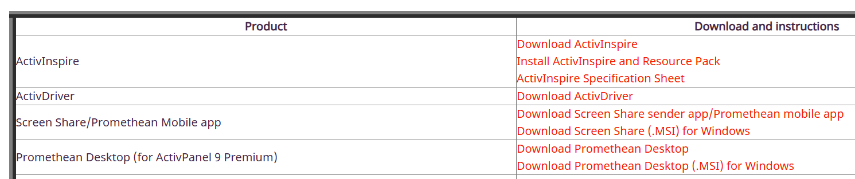
Download ActivInspire

Slide 4
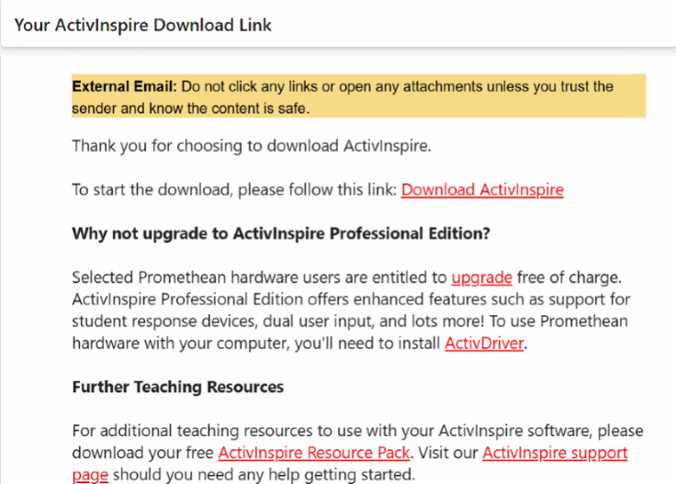
Watch for Email from Promethean

Slide 5

Promethean Board
Promethean Board was developed as the Activboard Interactive Whiteboard in 1996 by Promethean Ltd.
Historically, Promethean used a metal board controlled by a magnetic pen.
Created specifically for educational use.
Uses the flipchart as the
basis of the board vs.
PowerPoint.

Slide 6
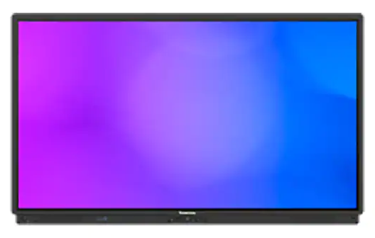
Promethean Board
The latest Promethean Board: ActivPanel 9

Slide 7
Promethean Board
The latest Promethean Board provides:
  Vellum touch technology with pen and finger differentiation, palm erase, advanced palm rejection, and 20-point touch.
  An integrated microphone array that captures voices in the classroom.
  Flexible connection options with seven forms of video inputs and outputs
  Improved viewing from anywhere in the classroom and increased writing accuracy with bonded glass.

Slide 8
Promethean Software
ActivPrimary
ActivStudio
ActivInspire Personal Edition: Version allows teachers, students, and parents to use ActivInspire tools, free of charge!
You can practice and prepare lessons using ActivInspire PE on your PC, even without access to the board.
ActivInspire

Slide 9
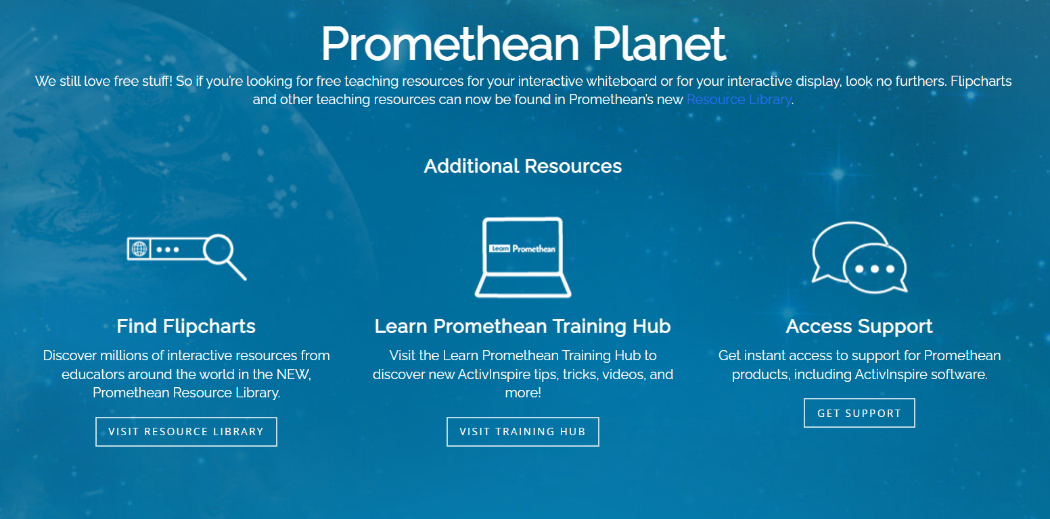
Free Resources
PrometheanPlanet.com

Slide 10
ActivInspire Professional Edition
ActivExpression student response systems.
Dual pen input capability.
Rich multimedia support including sound recorder and screen recorder.
Shape recognition and handwriting recognition tools.
Extensive customization features – create your own profile to suit your teaching style.
Realize that not all of the features of
ActivInspire are enabled in the personal edition.

Slide 11

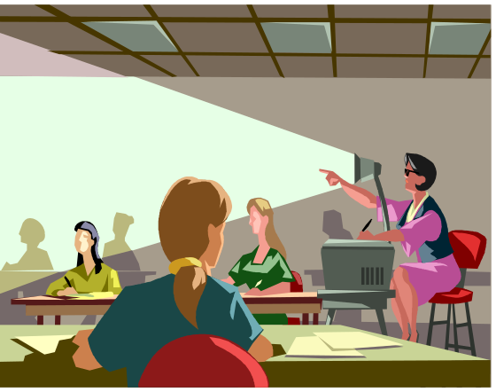
Benefits
Saves time: Teachers no longer have to write lesson material on the board. Instead, they can prepare their lessons in advance.
vs.
(Gatlin, 2004)
Notes:
Interactive Whiteboard System Creates 'Active Classrooms'for Rural Georgia School System. By: Gatlin, Mike, T H E Journal, 0192592X, Jan2004, Vol. 31, Issue 6

Slide 12
Benefits
Promethean is an electromagnetic IWB. Has a rigid, more durable surface than touch-sensitive boards.
Pen has hover and right-click functionality.
Students (and teachers) who lack the fine motor skills necessary to write on a board without resting their hand on it can do so on ActivBoards without creating virtual smudges.
(Hastings, 2010)
Notes:
Promethean ActivBoard 370 Pro Series. By: Hastings, Jeffrey, School Library Journal, 03628930, Mar2010, Vol. 56, Issue 3

Slide 13
Active Learners
Promethean Board was created for education (unlike the SmartBoard that was created for business).
It was designed to help teachers change students from passive to active learners.

Slide 14
Active Learners
Students can:
  Interact verbally.
  Come up to the board individually.
  Work from their seats with the ActivSlate.
  Participate as a group using ActiVotes or ActivExpression.

Slide 15
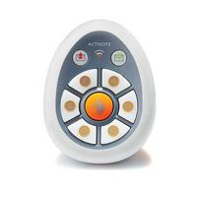
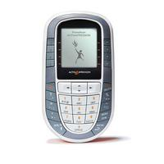
Creating Active Learners:
Student Response Systems
ActiVote
ActivExpression

Slide 16
Creating Active Learners
Interactive review games: Create & project a list of questions with multiple-choice answers. Student contestants use ActivSlate to control the whiteboard from their seats and select the answers.
If a student needs help, he/she could poll fellow classmates who used the ActiVote to select the answer they thought was correct.
(Gatlin, 2004)

Slide 17
Creating Active Learners
Assessment: Teachers can administer quizzes and tests.
Obtain instant results that indicate which areas students understand and which areas need to be readdressed.
Promethean's ActivExpression student response system allows for two-way texting of questions and answers in addition to multiple choice quizzes and polls.
(Gatlin, 2004)

Slide 18
What You Will Learn
In class, we are going to learn:
  How to use the tools available in ActivInspire.
  How to use the browsers in ActivInspire.
  Gain hands-on experience in how to teach using the Promethean Board.
  How to perform some advanced, interactive techniques in ActivInspire.
Ultimately, you will individually create a basic flipchart that you could use in teaching.

Slide 19
Working with ActivInspire and the Promethean Board

Slide 20
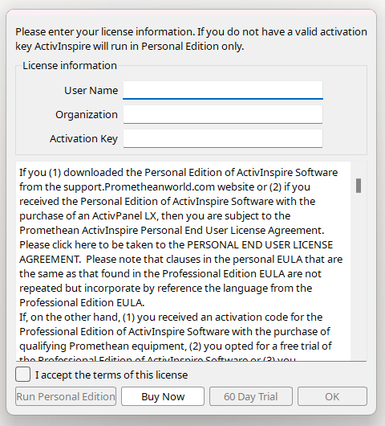
Starting ActivInspire
Skip this information.
Accept the terms and select “Run Personal Edition.”

Slide 21
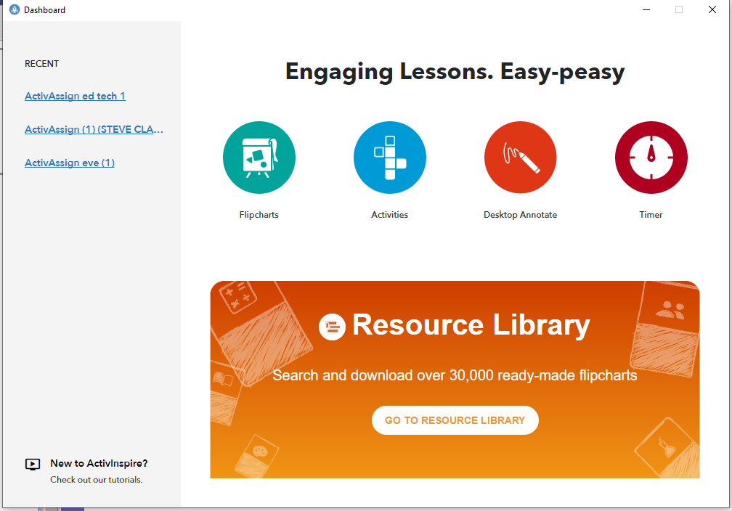
Dashboard

Slide 22
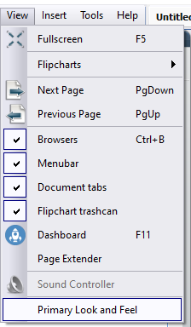
2 Interfaces
Primary: Ideal for use with early childhood students.
Studio: Ideal for use with older students.

Slide 23
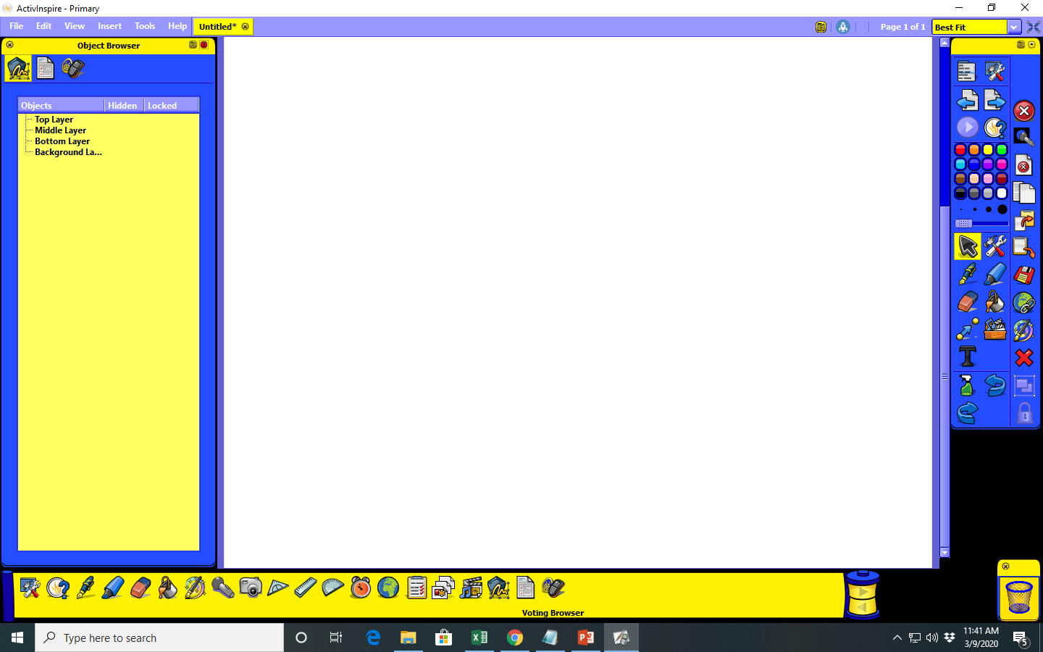
Layout Differences in “Primary”
Page and resource browsers in "primary" interface are located in the tools area. Click on “tools” and the contents of both will appear at the bottom of the screen.
Click on “tools.”
Object browser
Resource browser
Page browser

Slide 24
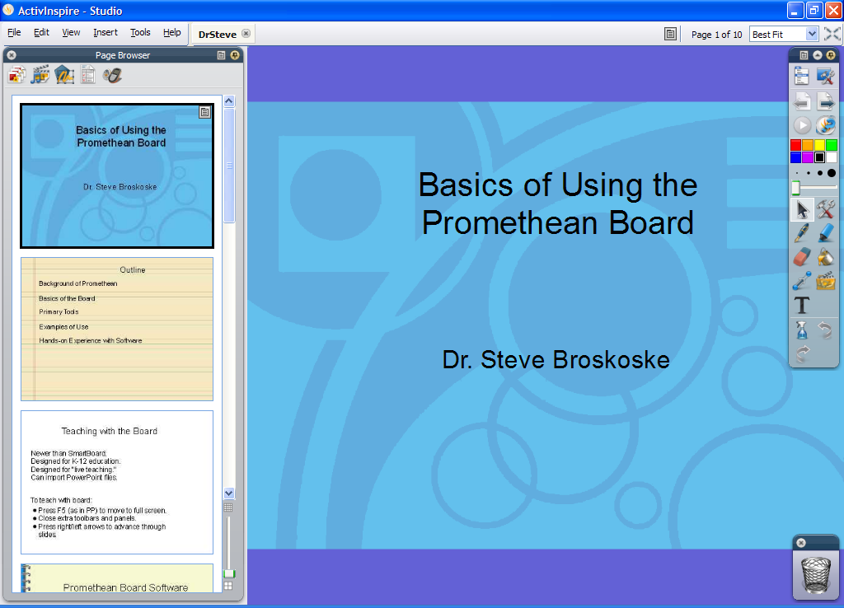
ActivInspire Software

Slide 25

Main Tools
Menu
Roll up
Flip chart pages
Show desktop
ExpressPoll
Pen/marker tools
Show tools

Slide 26
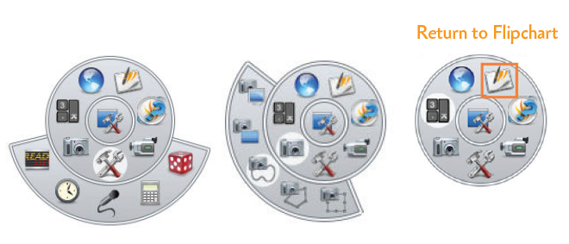
Desktop Tools Wonder Wheel
After you select show desktop, use the desktop tools wonder wheel to access ActivInspire tools, and to return to the flipchart.

Slide 27
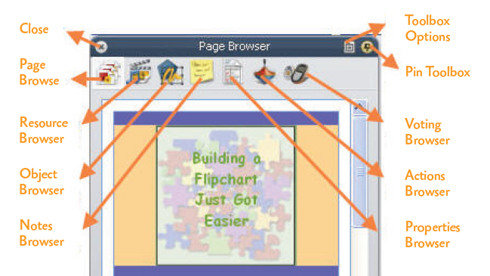
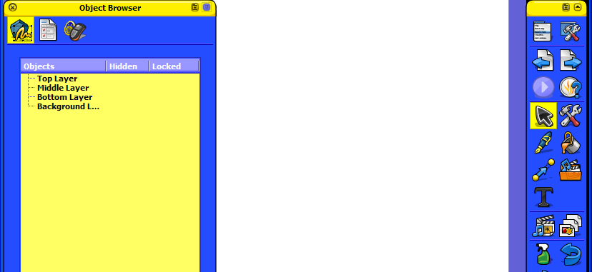
Browsers in ActivInspire

Slide 28
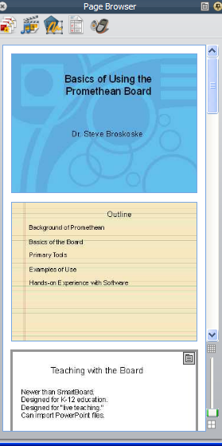
Browsers in ActivInspire
Page: Navigate between flipchart pages.
Resource: Add graphics to pages.
Object: Access and control objects.
Notes: Access teaching notes.
Property: Change aspects of objects.
Voting: Work with student response devices.
Action: Create action settings.

Slide 29
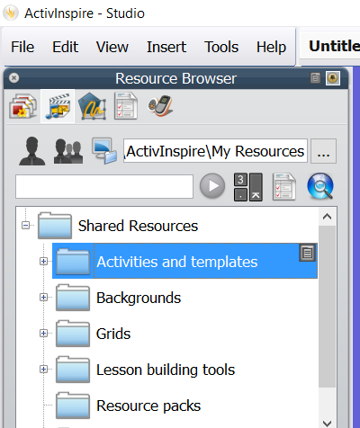
Backgrounds
From the resource browser, you can add backgrounds.

Slide 30
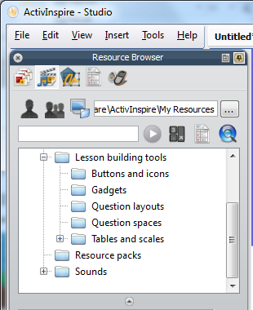
Interactive Elements:
Lesson Building Tools
Utilize “lesson building tools” in the resource browser to add interactive elements.

Slide 31
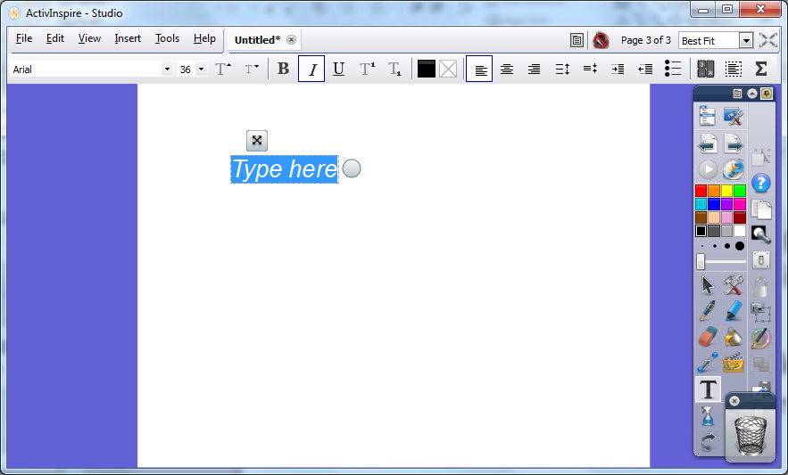
Adding/Editing Text

Slide 32
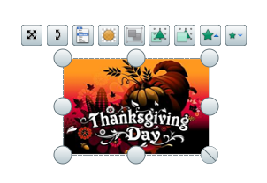
Inserting Graphics
Locate a graphic in the resource browser OR online (Google images or Microsoft gallery).
Drag a graphic onto a flipchart page.
User tools to edit/work with graphic.

Slide 33
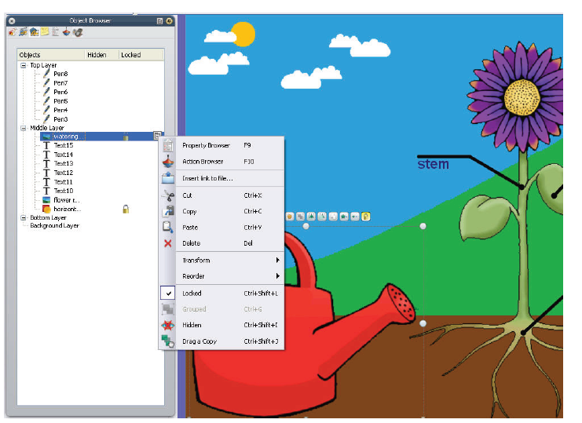
Use Object Browser
Reorder objects:
  Reorder within a layer.
  Reorder to a different layer.
Lock objects.

Slide 34
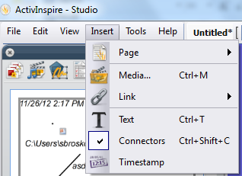
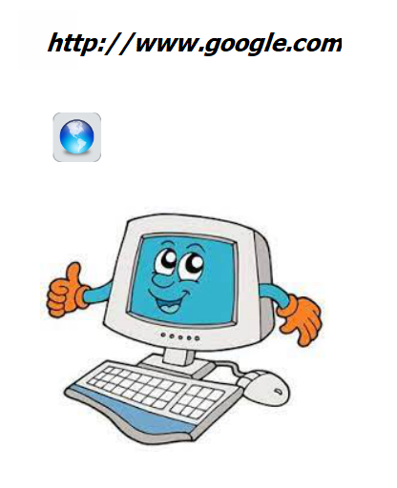
Interactive Elements:
Multimedia and Links
Insert link:
  Website
Text
Object
Existing object

Slide 35
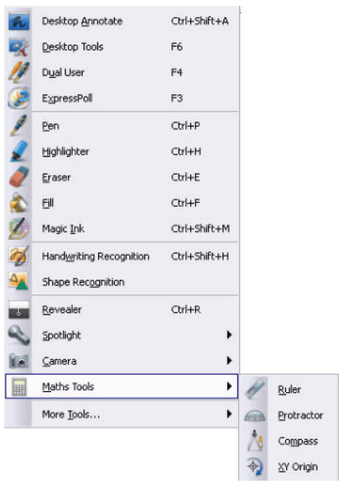
Tools for Teaching at the Board
Use the many tools to teach live with the Promethean Board.
Handwriting and shape recognition (among others) are not available in the personal edition.

Slide 36
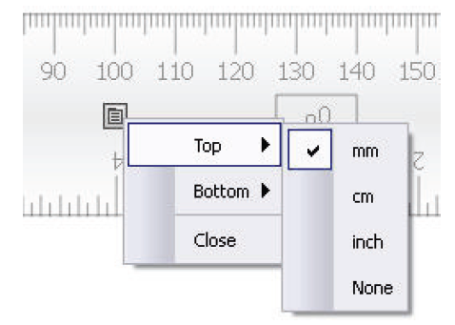
Using Math (and Other) Tools

Slide 37
ActivInspire Assignment
Over the next few class sessions, we will work on preparing a presentation using ActivInspire for the Promethean Board.
Start creating a basic presentation today.
Choose a topic in some curricular area to teach.
At the next class, we will learn how to add more advanced elements to the presentation.

Slide 38
ActivInspire Assignment
Create a flipchart to briefly teach some content. Include the following elements in the flipchart:
  Use text and graphics.
  Add a hypertext link to a video or Website.
  Include a background on at least one flipchart page (from resource or property browser).
  Hide some material behind another object (like the hat). [We will cover these skills in our next class meeting.]

